Slide 1
Matrix Algebra

Slide 2
Matrix operation

Slide 3
Matrix operation

Slide 4
Matrix operation

Slide 5
Matrix operation

Slide 6
Matrix Multiplication

Slide 7
Matrix Multiplication

Slide 8





Example

Slide 9
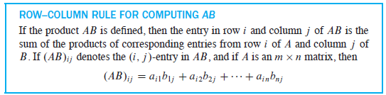

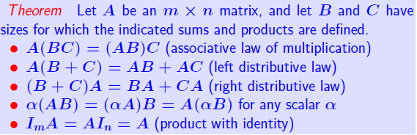

Slide 10
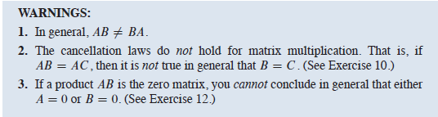
AB and BA are usually not the same
If AB = BA, we say that A and B commute with one another.

Slide 11
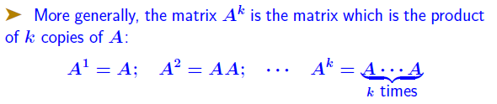
Square matrices, Matrix powers

Slide 12






Transpose of a matrix

Slide 13
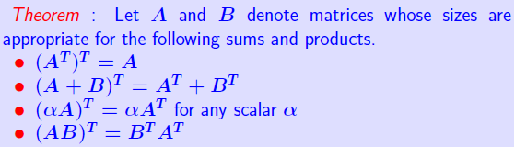

Transpose of a matrix

Slide 14
INVERSE OF A MATRIX

Slide 15


Inverse of a matrix

Slide 16
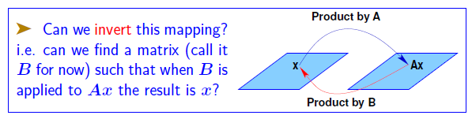

Introduction

Slide 17




Inverse of a matrix

Slide 18
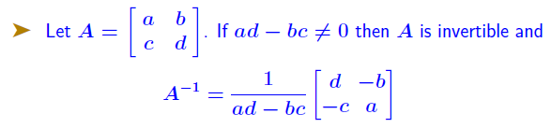


Matrix inverse - the 2*2 case

Slide 19
example
A matrix that is not invertible is sometimes called a singular matrix, and an invertible matrix is called a nonsingular matrix.

Slide 20


Matrix inverse - Properties
proof

Slide 21
Theorem
proof

Slide 22

example

Slide 23
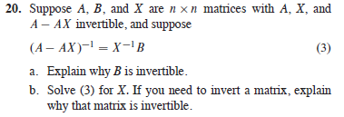
example

Slide 24
There is an important connection between invertible matrices and row operations that leads to a method for computing inverses
an invertible matrix A is row equivalent to an identity matrix

Slide 25
Elementary Matrices
An elementary matrix is one that is obtained by performing a single elementary row operation on an identity matrix

Slide 26
Elementary Matrices
Since row operations are reversible, elementary matrices are invertible
if E is produced by a row operation on I, then there is another row operation of the same type that changes E back into I

Slide 27
Example

Slide 28
Theorem
proof

Slide 29
Example

Slide 30
Another View of Matrix Inversion
This observation is useful because some applied problems may require finding
only one or two columns of A⁻¹ In this case, only the corresponding systems
need be solved.

Slide 31




example

Slide 32
CHARACTERIZATIONS
OF
INVERTIBLE MATRICES

Slide 33
Theorem

Slide 34
example

Slide 35
Each statement in the theorem describes a property of every n*n invertible matrix.
Invertible Matrix Theorem applies only to square matrices

Slide 36
Invertible Linear Transformations

Slide 37
example
When is a square upper triangular matrix invertible?
When is a square lower triangular matrix invertible?

Slide 38
PARTITIONED MATRICES

Slide 39
Partitioned Matrices
Partitioned or block Matrix

Slide 40
Operations on block matrices
Addition
If matrices A and B are the same size and are partitioned in exactly the same way,
then it is natural to make the same partition of the ordinary matrix sum A + B
Multiplication
Partitioned matrices can be multiplied by the usual row–column rule as if the block
entries were scalars, provided that for a product AB, the column partition of A matches the row partition of B.

Slide 41
Partitioned Matrices
Example:

Slide 42
Example

Slide 43
Block Matrices
proof

Slide 44
Altinbus
A block diagonal matrix is a partitioned matrix with zero blocks off the main
diagonal (of blocks). Such a matrix is invertible if and only if each block on the diagonal
is invertible.

Slide 45
example

Slide 46
Matrix Factorization

Slide 47
Matrix Factorization
A factorization of a matrix A is an equation that expresses A as a product of two or more matrices.

Slide 48
Matrix Factorization
it is more efficient to solve the first equation in sequence by row reduction and obtain an LU factorization of A at the same time
assume that A is an m*n matrix that can be row reduced to echelon form, without row interchanges.

Slide 49
Matrix Factorization
why they are so useful?

Slide 50
example

Slide 51
LU decomposition
row reduction of A to an echelon form U amounts to an LU factorization because it produces L with essentially no extra work
LU Factorization Algorithm
Suppose A can be reduced to an echelon form U using only row replacements that add a multiple of one row to another row below it
there exist unit lower triangular elementary matrices E1; : : : ;Ep such that

Slide 52
LU Decomposition
row operations which reduce A to U, also reduce L in equation to I

Slide 53
Example
The first column of L is the first
column of A divided by the top pivot entry:

Slide 54
Example

